Slide 1
Telecom Network Quality Analytics
Azure Databricks Medallion pipeline​
Bronze • Silver • Gold | Dashboard | MLflow | Genie​
Yash Desai
Shreya Mane
Moneshwaran
Dommaraju Chaithrika
Jenifer Thangam
Notes:
Introduce the project and the five team members. One-line pitch: we built a governed Bronze-Silver-Gold Databricks pipeline that turns six telecom datasets (13,454 source records) into trusted network-quality analytics, a dashboard, an MLflow anomaly model and a Genie space.

Slide 2
Fragmented telecom data hides network quality problems
TELECOM NETWORK QUALITY ANALYTICS | PROBLEM STATEMENT
Problem statement
6
Source datasets
Azure SQL (3) + ADLS Gen2 (3)
13,454
Source records
Documented Bronze baseline
Telecom network data is fragmented across multiple sources, making it difficult to accurately monitor network quality, outages and customer impact. Duplicate measurements, invalid values and broken tower / cell / region references distort KPIs and make joins unreliable.
Proposed solution
3
Medallion layers
Bronze, Silver, Gold
129
Data-quality rules
Catalogued in Silver
A governed Databricks Lakehouse using Bronze → Silver → Gold Medallion Architecture to ingest, validate, transform and analyse network, outage and customer-complaint data for reliable KPI monitoring and faster decisions.
Business objectives
Measure quality: latency, packet loss, throughput, availability
Understand outages by tower, region, severity, type, duration
Compare KPIs during outage windows with a normal baseline
Relate outages to customer complaints (possible impact)
Compare regional and service-tier performance
Build trust with DQ rules, traceable rejects, validation, regression
Why it matters
Duplicate rows inflate counts and distort averages
Negative latency (-999 placeholders) corrupts KPIs
Outages must be matched to telemetry and complaints by tower and time
Notes:
Problem: master data, KPI telemetry, outages and complaints live in separate systems, with duplicates, invalid values and broken references. Solution: governed Medallion pipeline. Numbers to quote: 6 datasets, 13,454 source records, 3 layers, 129 DQ rules.

Slide 3
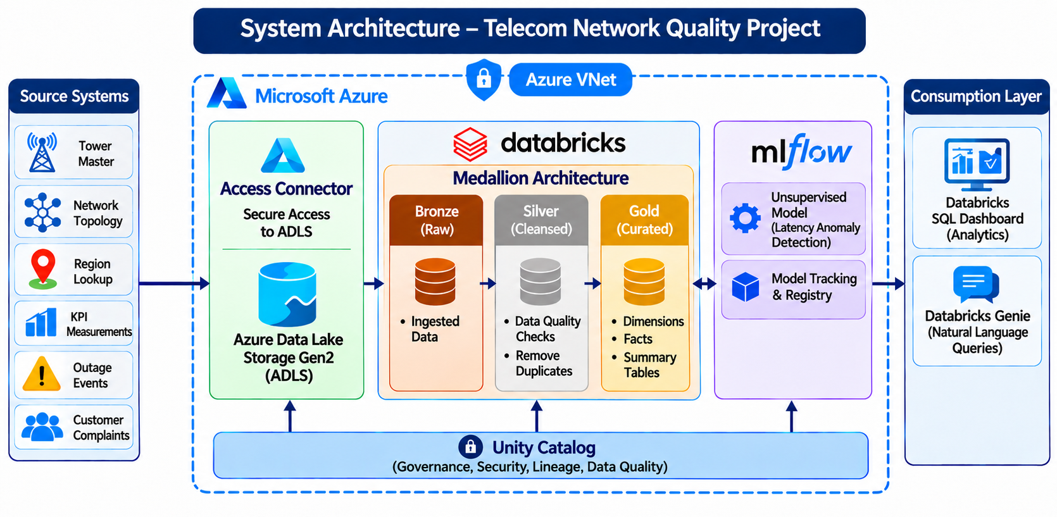
System architecture: sources to insight on Azure Databricks
TELECOM NETWORK QUALITY ANALYTICS | SYSTEM ARCHITECTURE
Key components
Sources: Azure SQL (3 masters) + ADLS Gen2 landing files (3 feeds)
Ingestion: JDBC with secret scope; Auto Loader with checkpoints
Azure SQL
Databases
Compute and storage: Databricks serverless, PySpark / Spark SQL, Delta Lake
Governance: Unity Catalog: catalog capstone6_telecom; schemas bronze, silver, gold
ML: MLflow: IsolationForest latency anomaly model, UC registry
Consumption: Databricks SQL dashboard and Genie space over Gold
Platform: Azure Databricks | Delta Lake | Unity Catalog | Databricks Workflows | MLflow
Notes:
Walk the diagram left to right: six sources, ADLS via access connector, Databricks Medallion, MLflow, consumption layer (SQL dashboard and Genie), Unity Catalog underneath for governance, all shown inside the Azure VNet boundary.

Slide 4
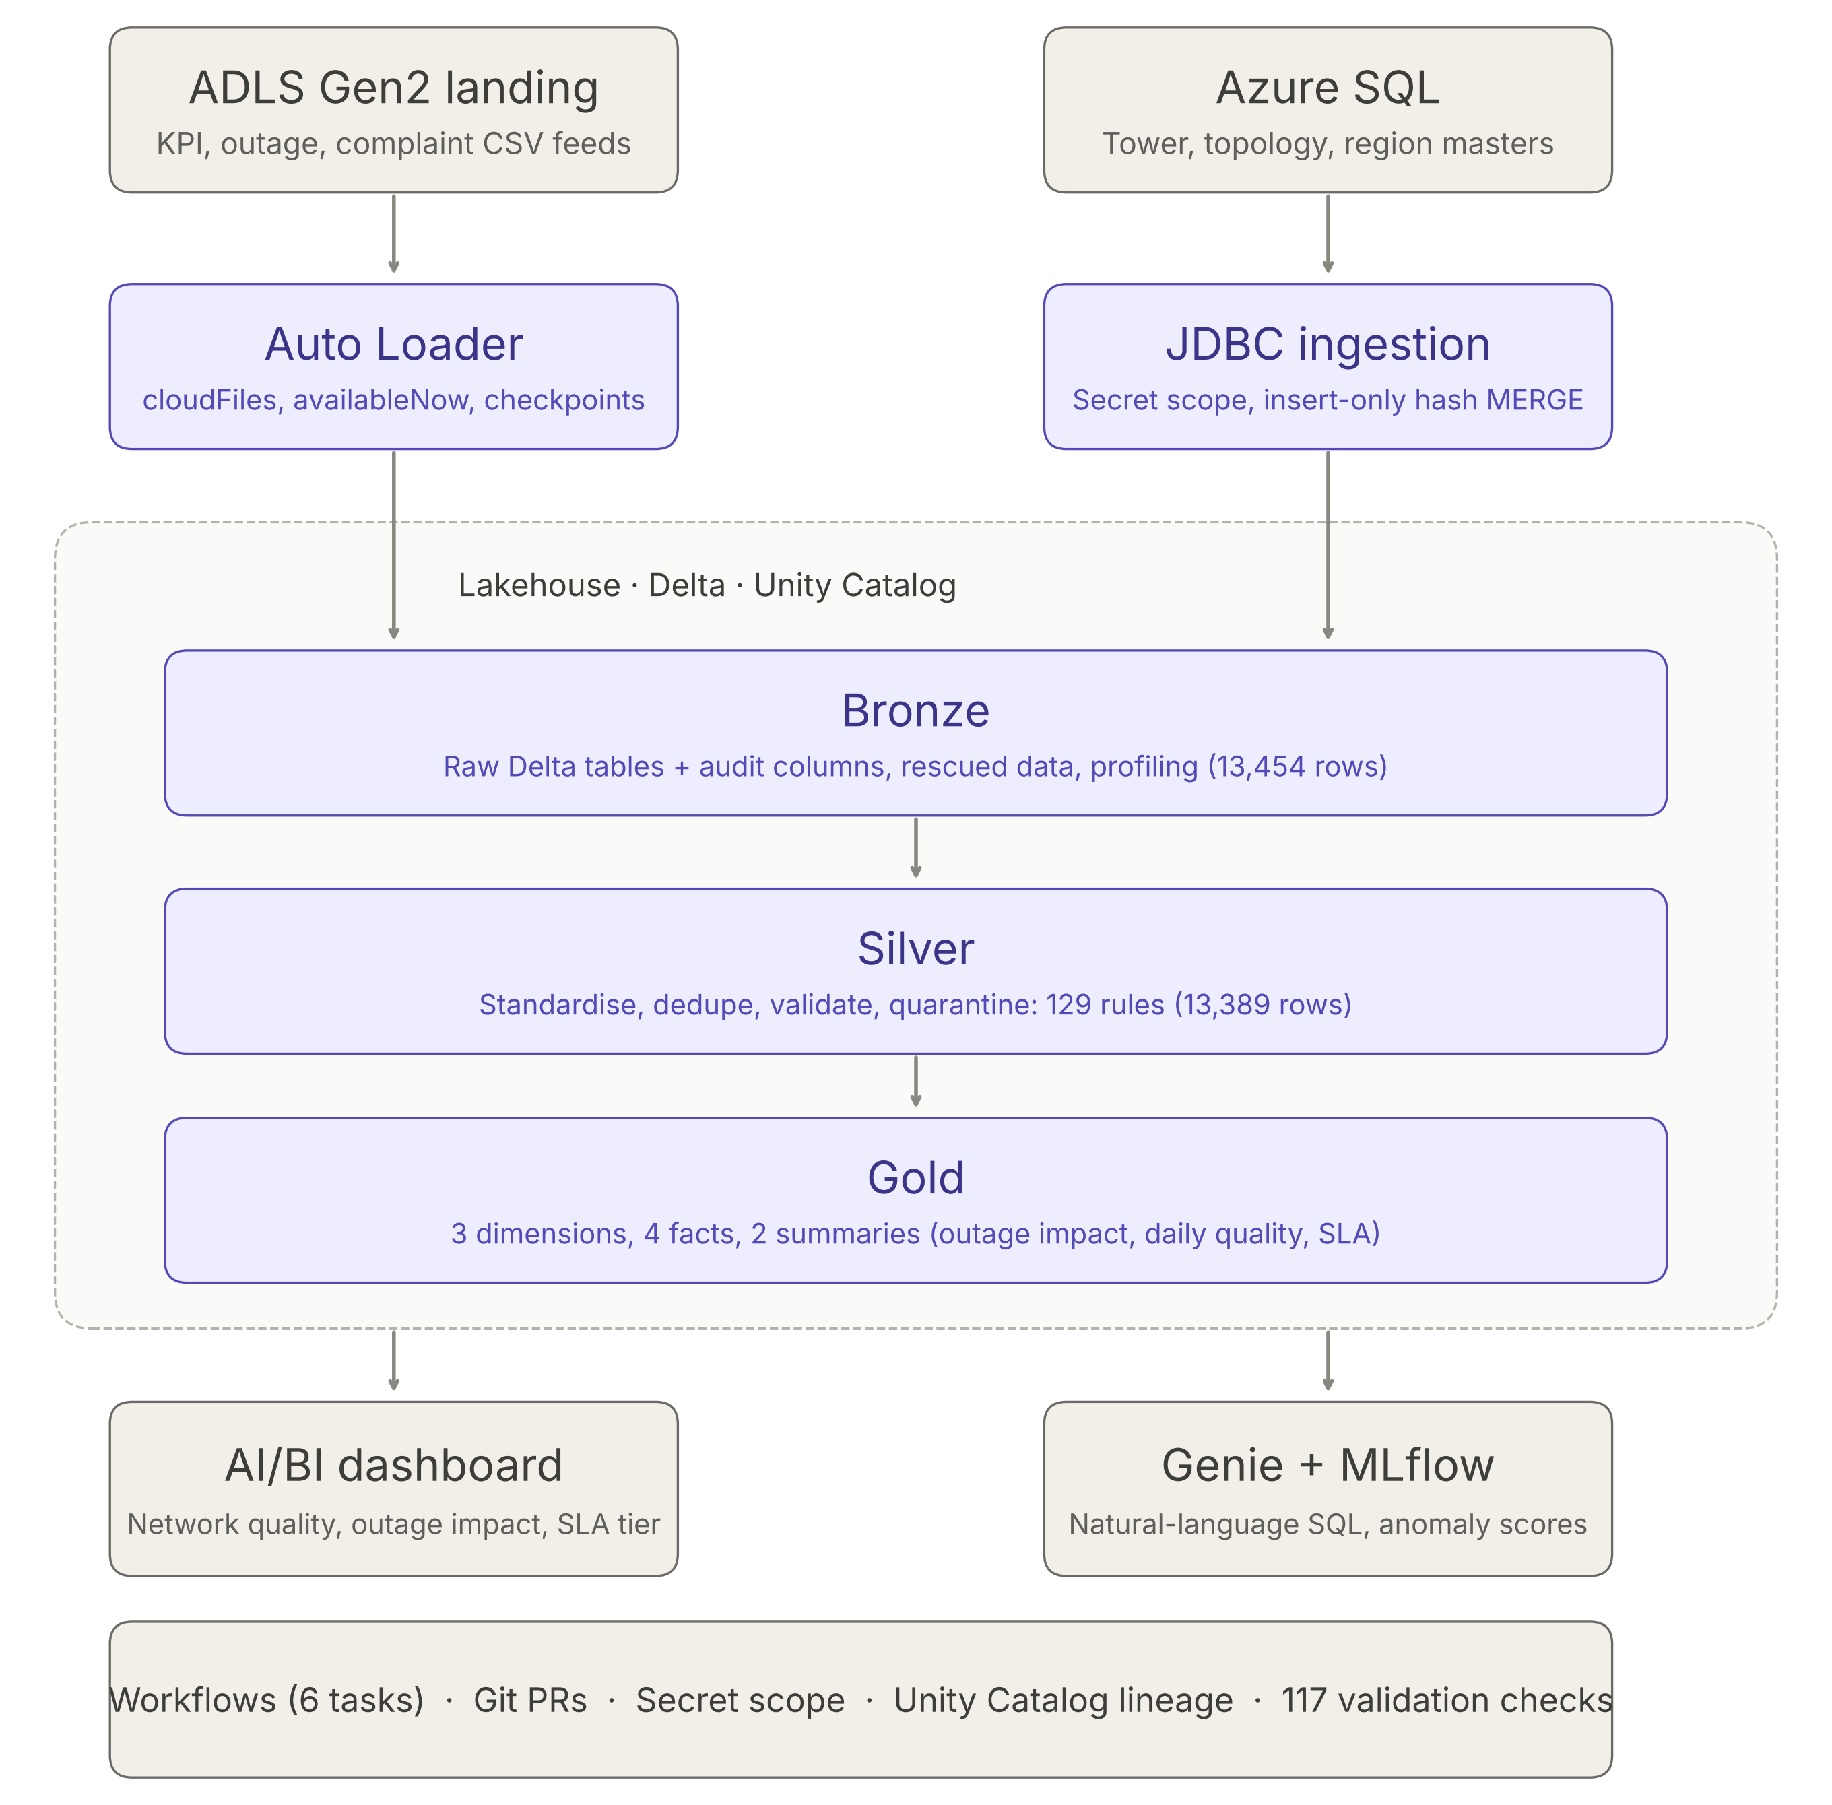
High-level design (HLD): layered platform view
TELECOM NETWORK QUALITY ANALYTICS | SYSTEM ARCHITECTURE | HLD
What the HLD shows
Ingest
ADLS landing files via Auto Loader; Azure SQL masters via JDBC
Store and process
Delta Lakehouse: Bronze (raw), Silver (clean), Gold (curated)
Consume
AI/BI dashboard and Genie space read Gold tables only
Operate and govern
Workflows, secret scope, Unity Catalog permissions and lineage
7
Workflow tasks
3
Schemas
1
Catalog
Notes:
HLD shows the logical flow: ADLS landing files via Auto Loader and Azure SQL masters via JDBC (insert-only hash MERGE), the Lakehouse (Bronze/Silver/Gold on Delta with Unity Catalog), then the AI/BI dashboard and Genie plus MLflow, with workflows, Git PRs, secrets, lineage and 117 validation checks around it. Emphasise separation of responsibilities per layer.

Slide 5
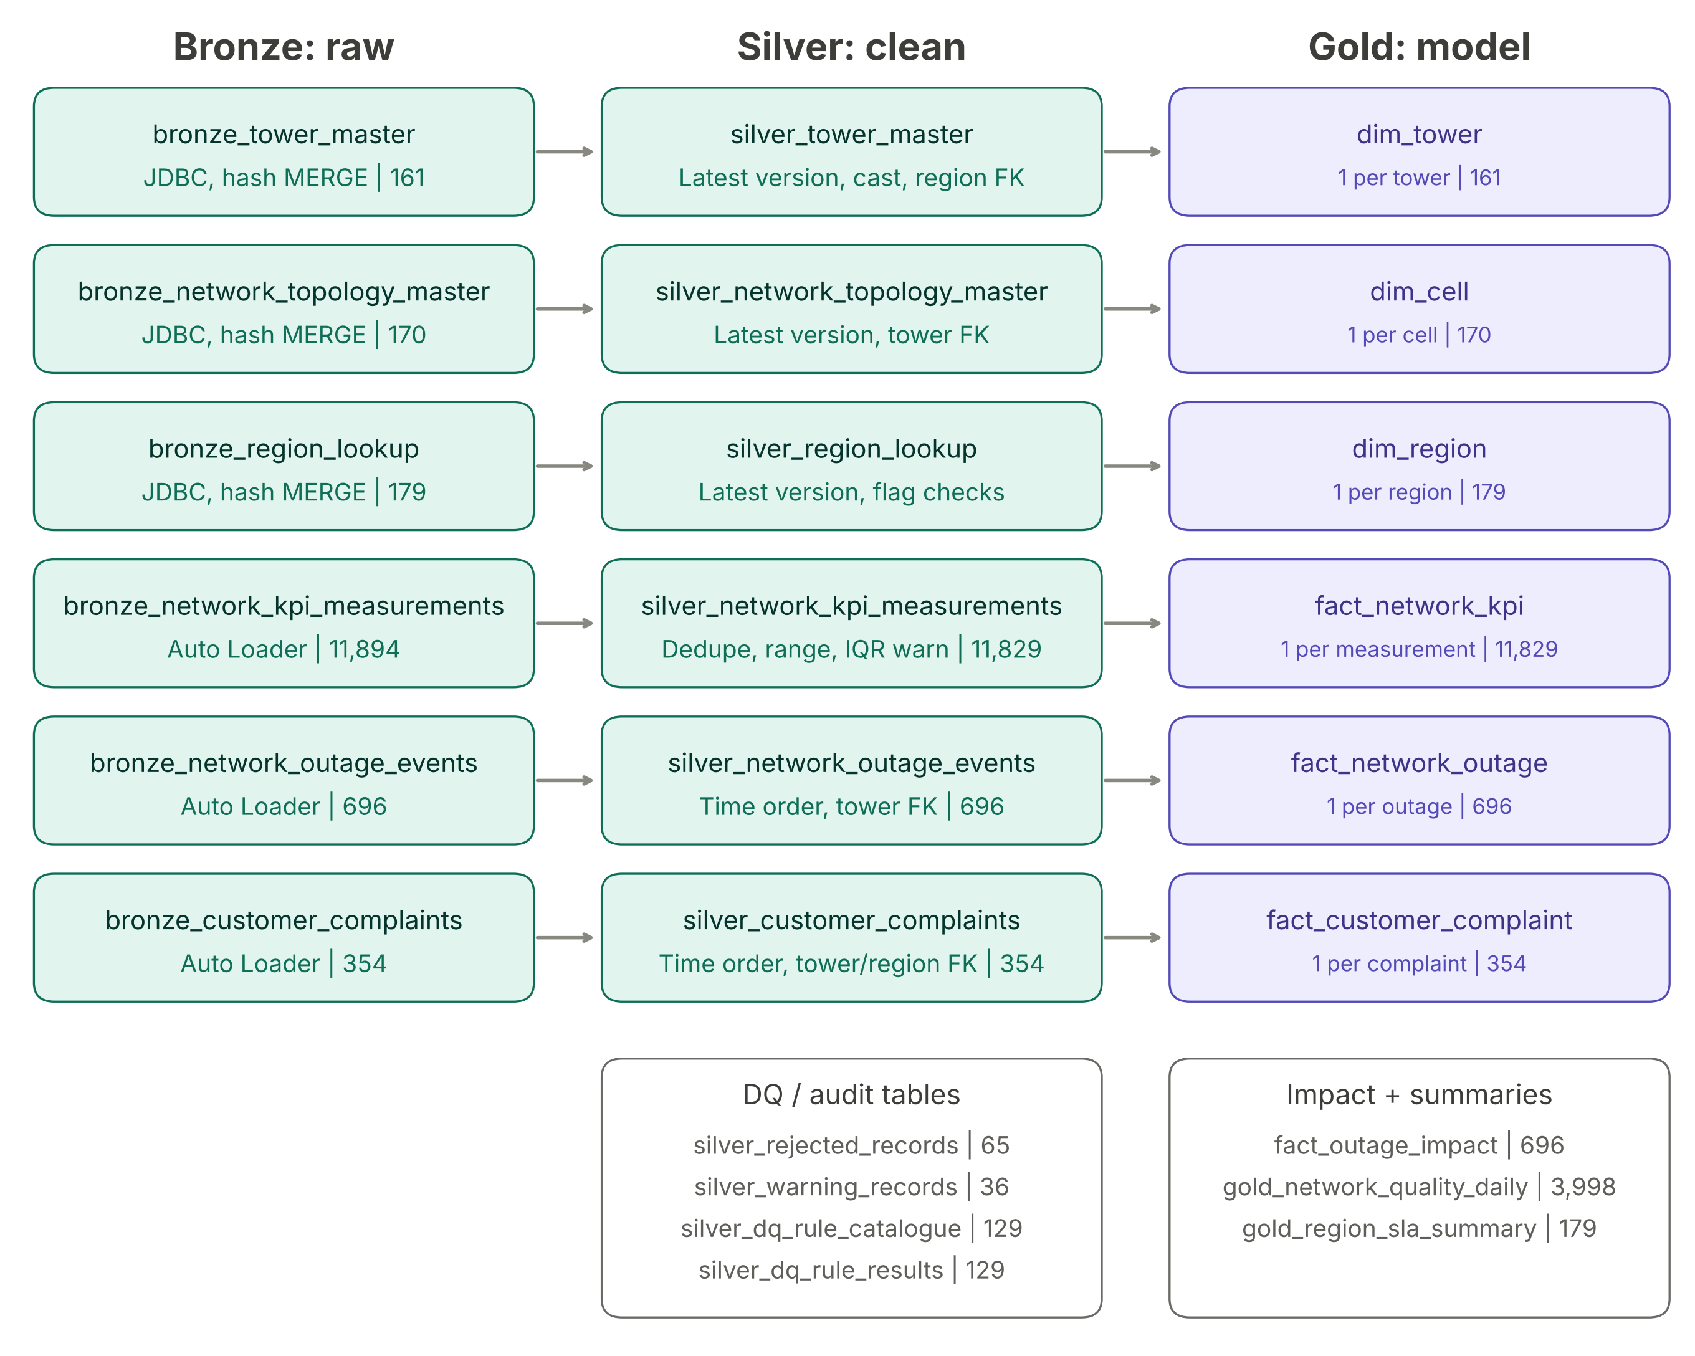
Low-level design (LLD): table-by-table lineage
TELECOM NETWORK QUALITY ANALYTICS | SYSTEM ARCHITECTURE | LLD
Lineage in numbers
Entity | Bronze | Silver | Gold
Tower | 161 | 161 | dim_tower 161
Topology / cell | 170 | 170 | dim_cell 170
Region | 179 | 179 | dim_region 179
KPI | 11,894 | 11,829 | fact 11,829
Outage | 696 | 696 | fact 696
Complaint | 354 | 354 | fact 354
Total | 13,454 | 13,389 | 9 tables
Reading the diagram
Silver rejects 65 KPI rows (43 duplicates + 22 negative latency): 13,454 - 65 = 13,389
silver_rejected_records holds rejected records with reason and source JSON; silver_warning_records logs kept warnings
Notes:
LLD maps every Bronze table to its Silver table and then to the Gold model with row counts. Six Bronze tables become six Silver tables, the four DQ/audit tables hold rejects, warnings, the 129-rule catalogue and per-rule results, and Gold has 3 dimensions, 4 facts (including fact_outage_impact) and 2 summaries.

Slide 6
Entity relationship diagram (ERD): six source datasets
TELECOM NETWORK QUALITY ANALYTICS | SYSTEM ARCHITECTURE | ERD
region_lookup Lookup | 179 rows
tower_master Master | 161 rows
network_topology_master Master | 170
region_id PK
region_name
state
country
service_zone
market_segment
sla_tier
active_flag
operations_center
timezone
1:N
tower_id PK
region_id FK
site_name
latitude
longitude
site_type
network_generation
activation_date
tower_status
operator_code
1:N
cell_id PK
tower_id FK
region_id FK
frequency_band
sector
technology
planned_capacity
active_flag
commissioned_date
vendor
region 1:N complaints
tower 1:N outages
cell 1:N KPI
customer_complaints Event | 354 rows
network_outage_events Event | 696 rows
network_kpi_measurements Telemetry | 11,894
complaint_id PK
tower_id FK
region_id FK
customer_id
complaint_ts
complaint_type
severity
channel
ticket_status
resolved_ts
outage_id PK
tower_id FK
outage_start_ts
outage_end_ts
outage_type
severity
root_cause_code
affected_cells
incident_status
reported_ts
measurement_id PK
tower_id FK
cell_id FK
region_id FK
measurement_ts
latency_ms
packet_loss_pct
throughput_mbps
active_sessions
network_generation
availability_pct
ingestion_ts
PK business key FK reference checked in Silver (REJECT if not found in clean master). Solid lines: primary relationship; thin lines: tower 1:N complaints and tower 1:N KPI. region_id also appears on topology and KPI. SILVER / BRONZE in region_lookup.sla_tier are service tiers, not Medallion layers.
Notes:
ERD: region is the top-level reference; each tower belongs to a region; each cell belongs to a tower; KPI telemetry references tower, cell and region; outages reference tower; complaints reference tower and region. These foreign keys are exactly what Silver referential checks enforce.

Slide 7
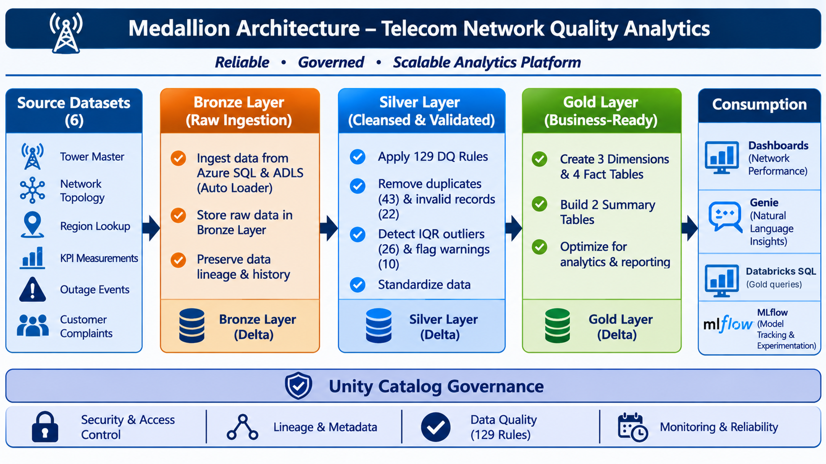
Medallion architecture: preserve, trust, then use
TELECOM NETWORK QUALITY ANALYTICS | MEDALLION ARCHITECTURE
Bronze
13,454 rows, 6 tables
Raw + ingestion metadata + profiling
Silver
13,389 rows, 6 tables
+ 4 DQ / audit tables; 129 rules
Gold
9 tables + anomaly scores
3 dimensions, 4 facts, 2 summaries
Bronze preserves what arrived. Silver makes data trustworthy. Gold makes it useful.
Notes:
Bronze preserves what arrived, Silver decides whether a record is usable and records quality findings, Gold shapes trusted data into business questions. Row flow: 13,454 into Bronze, 13,389 after 65 KPI rejections in Silver, 9 Gold tables.

Slide 8
Dataset specifications: six sources, three kinds of data
TELECOM NETWORK QUALITY ANALYTICS | DATASETS | SPECIFICATIONS
Dataset | Class / source | Business key | One row = | Cols | Bronze | Silver
tower_master | Master | Azure SQL JDBC | tower_id | One tower / site | 10 | 161 | 161
network_topology_master | Master | Azure SQL JDBC | cell_id | One cell and its tower | 10 | 170 | 170
region_lookup | Lookup | Azure SQL JDBC | region_id | One reporting region | 10 | 179 | 179
network_kpi_measurements | Telemetry | ADLS Auto Loader | measurement_id | One time-stamped KPI reading | 12 | 11,894 | 11,829
network_outage_events | Event | ADLS Auto Loader | outage_id | One outage incident | 10 | 696 | 696
customer_complaints | Event | ADLS Auto Loader | complaint_id | One complaint ticket | 10 | 354 | 354
13,454
Total source records
161+170+179+11,894+696+354
58 days
Telemetry coverage
1 Jul to 27 Aug 2026
4 days
Outage coverage
1 Jul to 4 Jul 2026
2 days
Complaint coverage
1 Jul to 2 Jul 2026
Notes:
Each dataset has its own grain and role. Master data via JDBC, telemetry and events via Auto Loader. Telemetry covers 1 Jul to 27 Aug 2026 (58 days); outages cover 1-4 Jul; complaints 1-2 Jul, so impact analysis is limited to those windows. SILVER/BRONZE in region_lookup are tiers, not layers.

Slide 9
Data ingestion from the landing zone
TELECOM NETWORK QUALITY ANALYTICS | DATA INGESTION
Landing volume
ext_raw_landing
telemetry_data, event_data
Auto Loader
cloudFiles, CSV
trigger(availableNow)
State volume
autoloader_metadata
schema + checkpoints
Bronze Delta
Append-mode writeStream
+ audit columns
Feed | Landing path | File pattern | Bronze target | Rows
KPI telemetry | telemetry_data | network_kpi_measurements*.csv | bronze_network_kpi_measurements | 11,894
Outage events | event_data | network_outage_events*.csv | bronze_network_outage_events | 696
Complaints | event_data | customer_complaints*.csv | bronze_customer_complaints | 354
Auto Loader options
header=true, includeExistingFiles=true
inferColumnTypes=false; schemaEvolutionMode=rescue
pathGlobFilter per feed; checkpoint per feed
Unexpected fields kept in _rescued_data
Adding or correcting files
New data: drop new file names into the landing folders
Corrected file with an old name is ignored: rename it
Full reset: pause trigger, truncate Bronze, clear checkpoint, rerun
Notes:
Files land in the managed volume ext_raw_landing. Auto Loader (cloudFiles) reads them incrementally with availableNow, which processes what is available and stops: bounded streaming, not a continuous stream. Schema and checkpoint state live in a separate autoloader_metadata volume so they do not retrigger the file-arrival job. Same-name corrected files are ignored: rename them or run the documented full reset.

Slide 10
Bronze layer: ingest and preserve source evidence
TELECOM NETWORK QUALITY ANALYTICS | BRONZE LAYER
01
Bronze JDBC
Azure SQL masters
3 tables / 510 rows
Spark JDBC; sql-user and sql-pwd from secret scope azure-sql-scope
First run creates Delta; later runs insert-only MERGE
Changed content = new version; old evidence kept
tower 161 | topology 170 | region 179
02
Bronze ADLS
Auto Loader feeds
3 tables / 12,944 rows
cloudFiles CSV into append-mode Delta tables
Per-feed checkpoint; availableNow trigger
Audit: source system, feed, file path, ingestion time
_rescued_data retains unexpected fields
KPI 11,894 | outage 696 | complaints 354
03
Bronze Profiling
Raw data assessment
6 tables profiled
Business key per table (tower_id ... complaint_id)
Row count, duplicate key values
Null and distinct count for every column
Output: bronze_profiling_summary (overwritten each run)
Descriptive only: no cleaning or rejection
Handoff to Silver: 7 Bronze outputs (6 source tables + profiling summary), 13,454 rows, business keys, audit metadata and profiling findings.
Notes:
Three notebooks. JDBC: secret scope azure-sql-scope, SHA-256 content hash, insert-only MERGE so unchanged rows are not inserted again and changed rows become a new version. ADLS: Auto Loader into three Delta tables. Profiling: six tables, results to bronze_profiling_summary. Bronze is never updated or deleted in place.

Slide 11
Silver layer: standardise, validate, quarantine
TELECOM NETWORK QUALITY ANALYTICS | SILVER LAYER
1 Read Bronze
Bronze stays read-only
2 Standardise
Trim, blank to NULL, uppercase categories
Every issue gets one decision
REJECT
Unusable. Excluded from Silver; reason + source JSON stored in silver_rejected_records.
Missing key / mandatory field
Bad type or timestamp
Negative latency
Broken reference
Duplicate copy
WARN
Usable but suspicious. Kept in Silver with dq_warning_checks; logged in silver_warning_records.
IQR outlier
Missing optional field
Unexpected category
Late / out-of-order KPI
Cell / tower mismatch
3 Preserve raw
_raw, _record JSON, _row_hash, _lineage
4 Cast types
try_cast: bad values become NULL, then flagged
5 Deduplicate
Exact copies and latest version per key
6 Validate
Null, type, range, category, timestamp, reference
7 Detect outliers
IQR fences k=1.5 on rows passing rejects
8 Write outcomes
Silver tables + rejected / warning tables
Deduplication logic
Exact duplicate: same _row_hash; first delivery kept, later copies rejected
Same business key, new content: latest _ingested_at kept (versioned masters)
Business key = which entity; row hash = which exact content
Processing order: region → tower → topology → KPI / outage / complaints, so references validate against already-clean masters.
Notes:
One reusable engine (prepare and run_dataset) driven by a DATASETS configuration. Eight steps: read, standardise, preserve raw, cast, deduplicate, validate, outliers, write. REJECT excludes the record and stores evidence; WARN keeps the record flagged. Processing order is region, tower, topology, then KPI, outage, complaints so references are checked against clean masters.

Slide 12
Silver data quality: 129 rules and the KPI reconciliation
TELECOM NETWORK QUALITY ANALYTICS | SILVER LAYER | DQ RESULTS
11,894
Bronze KPI rows
43
Exact duplicates
22
Negative latency
11,829
Silver KPI rows
−
−
=
Finding | Count | Action
Exact duplicate KPI rows | 43 | REJECT
Negative latency (-999) | 22 | REJECT
Total KPI rejects | 65 | Excluded
IQR outlier findings | 26 | WARN, retained
Missing optional fields | 10 | WARN, retained
Total warning findings | 36 | Retained
Eight rule categories (129 rules in silver_dq_rule_catalogue)
NULL_CHECK | DUPLICATE | DATA_TYPE | NUMERIC_RANGE
CATEGORICAL | TIMESTAMP | REFERENTIAL | OUTLIER
Silver rows: tower 161, topology 170, region 179, KPI 11,829, outage 696, complaints 354 = 13,389.
Notes:
KPI reconciliation: 11,894 minus 43 exact duplicates minus 22 negative latency equals 11,829. The 26 IQR outliers and 10 missing-optional findings are warnings and do not reduce the row count; warnings are issue counts, not necessarily 36 unique rows. IQR: Q1 and Q3 via percentile_approx, fences at Q1 - 1.5 IQR and Q3 + 1.5 IQR, on five KPI measures. Gold then turns IQR_OUTLIER in dq_warning_checks into is_iqr_outlier.

Slide 13
Gold layer: business-ready dimensions, facts and summaries
TELECOM NETWORK QUALITY ANALYTICS | GOLD LAYER
Table | Type | Grain | Rows
dim_tower | Dimension | 1 per tower | 161
dim_cell | Dimension | 1 per cell | 170
dim_region | Dimension | 1 per region | 179
fact_network_kpi | Fact | 1 per measurement | 11,829
fact_network_outage | Fact | 1 per outage | 696
fact_customer_complaint | Fact | 1 per complaint | 354
fact_outage_impact | Fact | 1 per outage | 696
gold_network_quality_daily | Summary | 1 per region per day | 3,998
gold_region_sla_summary | Summary | 1 per region | 179
Outlier flag
is_iqr_outlier = array_contains(dq_warning_checks, IQR_OUTLIER). Primary latency excludes flagged rows; the inclusive average is kept too.
Region consistency
kpi_tower_region_match compares KPI region with tower master region; mismatches are kept and reported, not overwritten.
Derived fields
outage_duration_minutes = (end - start) / 60; measurement_date, outage_date, complaint_date; complaint region = its own region_id.
Integrity: one row per business key asserted for every dimension; fact_outage_impact row count asserted equal to fact_network_outage (696).
Notes:
Gold reads only the six Silver business tables, not the DQ audit tables. 3 dimensions, 4 facts, 2 summaries. Uniqueness is asserted before joins so counts cannot multiply. is_iqr_outlier is derived by array_contains on dq_warning_checks; Gold does not recalculate IQR. gold_network_quality_daily uses full joins so dates with only outages or complaints are not lost.

Slide 14
Gold analytics: outage impact on network and customers
TELECOM NETWORK QUALITY ANALYTICS | GOLD LAYER | OUTAGE IMPACT
Baseline: same tower outside windows
60 min before
During outage (start to end)
60 min after
Impact window = telemetry + complaints on the same tower_id. Deltas = window average minus baseline average (latency, availability, packet loss, throughput).
696
Outages
1 row each in fact_outage_impact
145
With telemetry evidence
20.8% of outages
51
With complaint evidence
7.3% of outages
3,480 min
Total outage duration
58 hours; about 5.0 min avg
Baseline KPI results (Gold)
84.58 ms
Avg latency excl. IQR outliers
97.50%
Avg availability
2.48%
Avg packet loss
5.33M Mbps
Throughput sum (not capacity)
Outages by type: POWER 251, HARDWARE 223, BACKHAUL 222. Note: association evidence only; 60-minute buffer is an adjustable assumption; throughput is a sum of readings.
Notes:
For each outage: telemetry on the same tower from 60 minutes before start to 60 minutes after end, compared with the same tower baseline outside all impact windows, plus complaints on that tower in the window. 145 of 696 outages have telemetry evidence (20.8 percent); 51 of 696 have complaints (7.3 percent). This is correlation, not proof of sole causation; the 60 minute buffer is an adjustable assumption.

Slide 15
Pipeline tasks and data flow: Capstone6 Telecom Medallion Pipeline
TELECOM NETWORK QUALITY ANALYTICS | WORKFLOW DIAGRAM | TASKS
# | Task / notebook | What it does | Retries
1 | bronze_jdbc | Loads Tower, Topology, Region masters from Azure SQL | 2
2 | bronze_adls | Loads KPI, Outage, Complaint files with Auto Loader | 1
3 | bronze_profiling | Row counts, nulls, distinct values, duplicate keys | 1
4 | silver_processing | Cleaning and data-quality rules (129 rules) | 1
5 | gold_analytics | Dimensions, facts and telecom business summaries | 1
6 | pipeline_validation | Checks data accuracy across all layers | 0
7 | Dashboard (consumer, not a job task) | Reads validated Gold data for reporting | -
6-7 min
Typical end-to-end run
Serverless compute
10 / 11
Documented runs succeeded
1 cancelled by user
300 s
Min trigger interval
File arrival + 60 s wait
MERGE
prevents identical JDBC records being inserted again
Checkpoints
Auto Loader never reprocesses a processed file
Dependencies
ensure notebooks run in the correct order
1
Concurrent run
Extra triggers queued
Notes:
Walk the table in order. Task dependencies enforce notebook order. Retries: JDBC 2, others 1, validation 0 so blocking failures stop the job. Trigger is file arrival with 300 s minimum interval and 60 s wait after last change; 10 of 11 documented runs succeeded and one was cancelled by the user, so never say all 11 succeeded.

Slide 16
Databricks Medallion pipeline: what it is and how it flows
TELECOM NETWORK QUALITY ANALYTICS | WORKFLOW DIAGRAM
What is a data pipeline? An automated sequence of tasks that moves and processes data from source systems to the final destination.
Azure SQL + ADLS
Bronze
Silver
Gold
Validation
Dashboard
Bronze
Stores raw data from Azure SQL using JDBC and from ADLS using Auto Loader.
6 tables, 13,454 rows
Silver
Cleans, standardises and validates the Bronze data.
129 rules, 65 KPI rejects
Gold
Creates business-ready dimensions, facts and analytical summaries.
3 dims, 4 facts, 2 summaries
Validation
Verifies the correctness and completeness of pipeline results.
117 checks, 43 regression
Dashboard
Reads validated Gold tables once upstream processing and validation have passed.
AI/BI + Genie
Bronze stores data, Silver improves data, and Gold gives business meaning to data.
Notes:
A data pipeline is an automated sequence of tasks that moves and processes data from source to destination. Ours: Azure SQL + ADLS, then Bronze, Silver, Gold, Validation, Dashboard. The dashboard and Genie consume the validated Gold tables.

Slide 17
Pipeline testing and validation
TELECOM NETWORK QUALITY ANALYTICS | TESTING AND VALIDATION
Testing
Verifies the pipeline logic behaves as expected.
Example: a KPI record with an invalid Tower ID must be rejected by Silver and its rejection reason stored.
Validation
Verifies output data is correct, complete and consistent across Bronze, Silver and Gold.
Blocking FAIL stops the task; non-blocking issues are WARN.
117 checks by layer
DQ reconciliation
Bronze violations = Silver detected issues = Stored DQ issues
Example: 10 = 10 = 10 → PASS
117/117
PASS in UAT
0
Region mismatches
A green job confirms the code ran successfully. Validation confirms the produced data is correct.
Results written to bronze_, silver_, gold_validation_summary. UAT baseline run: 4 Nov 2026.
Notes:
Testing checks the logic behaves as expected, for example an invalid Tower ID in a KPI record must be rejected with a reason. Validation checks the output data is correct, complete and consistent. DQ reconciliation: Bronze violations equal Silver detected issues equal stored DQ issues. 117 checks: Bronze 28, Silver 41, Gold 48; blocking failures fail the task. A green job proves the code ran; validation proves the data is right.

Slide 18
Regression testing: protecting what already works
TELECOM NETWORK QUALITY ANALYTICS | TESTING AND VALIDATION | REGRESSION
What is regression testing? Rerunning existing important tests after a code, rule or configuration change to confirm nothing that worked has broken.
Bronze Ingestion
Profiling
Silver Processing
Gold Analytics
Validation
Dashboard
43 / 43
Regression checks PASS
Frozen UAT baseline, 4 Nov 2026
117
Validation checks first
Then compared with baseline
6 / 6
Job tasks SUCCESS
In the UAT baseline run
What the final regression compares
Row counts in Bronze, Silver and Gold
DQ outcomes: 65 rejects, 36 warnings
Key Gold KPIs: 84.58 ms, 97.50%, 2.48%, 3,480 min; outages with evidence 145 / 51
Presence and status of the three validation summaries
When to run it
After any code, rule or configuration change
After a source change, then re-baseline only with approval
Idempotent replay: reruns reproduce the same Silver and Gold counts
Notes:
Regression testing means rerunning the important tests after a code, rule or configuration change. 07_Final_Regression compares row counts, DQ outcomes, key Gold KPI values and presence of validation summaries against a frozen UAT baseline; KPI tolerance 1e-3. 43 of 43 PASS. If new source data is accepted, re-baseline only with sign-off.

Slide 19
Dashboard: Telecom Network Quality overview
TELECOM NETWORK QUALITY ANALYTICS | DASHBOARD
97.50%
Average availability
84.58 ms
Average latency*
2.48%
Average packet loss
Outages by type (total 696)
696
Outages
354
Complaints
3,480 min
Outage duration
Pipeline health
Validation checks by layer: 28 + 41 + 48 = 117
Filters
Date range
SLA tier: BRONZE / SILVER
Charts
Daily average latency trend
Availability by SLA tier: 97.50% / 97.51%
Outages by type and severity
Reading the numbers
* Latency excludes 26 IQR outliers
SLA tier = classification; no pass/fail targets were supplied
Notes:
AI/BI dashboard built on Gold tables with Date range and SLA tier filters. Cards: availability 97.50 percent, latency 84.58 ms excluding IQR outliers, packet loss 2.48 percent, 696 outages, 354 complaints, 3,480 outage minutes. Charts: daily latency trend, availability by SLA tier, outages by type and severity, validation checks by layer. SLA tier is a classification, so do not call the chart SLA compliance.

Slide 20
MLflow anomaly model and Genie natural-language analytics
TELECOM NETWORK QUALITY ANALYTICS | MLFLOW AND GENIE
MLflow: unsupervised latency anomaly detection
Genie space over Gold
11,829
Rows scored
200
Trees
2,048
Max samples
0.01
Contamination
9
core Gold tables queryable in plain English
Features: 6 numeric (latency, packet loss, throughput, sessions, availability, hour of day) + 2 categorical (network generation, site type)
Example questions (illustrative)
Which region has the lowest average availability?
How many outages had customer complaints?
Show outage count by type and severity
Pipeline: Median imputation + scaling; most-frequent imputation + one-hot; IsolationForest (random_state 42)
Tracking and registry: Params, metrics, signature logged to MLflow; model registered in Unity Catalog with alias champion
Together
IQR rules give explainable flags; the model adds a multivariate view of unusual KPI readings.
Output: Champion scores every row into gold.kpi_anomaly_scores (anomaly_score, is_anomaly); rerun-safe overwrite
Notes:
MLflow: notebook 08 trains an unsupervised IsolationForest on fact_network_kpi (11,829 rows), tracks params and metrics in MLflow, registers it in Unity Catalog as latency_anomaly_model with alias champion, and writes scores to kpi_anomaly_scores. The IQR flag is a rule-based flag, not ground truth, so it is used only to evaluate precision, recall and F1, never as a training label. Genie: natural-language questions over the nine Gold tables. State the evaluation numbers only from your own MLflow run.

Slide 21
UAT sign-off: 13 of 15 acceptance criteria passed, 2 open
TELECOM NETWORK QUALITY ANALYTICS | TESTING AND VALIDATION | UAT
Check | Evidence | Result
Bronze preserves raw evidence | 161 / 170 / 179 / 11,894 / 696 / 354 rows match sources; profiling summary written | PASS
DQ rules catalogued | 129 rules with rule ID, severity, action and validation query | PASS
Rejects traceable, warnings kept | 65 rejects (43 duplicates + 22 latency -999) with rule_id and source JSON; 36 warnings retained | PASS
Reconciliation | Bronze = Silver + rejected on all 6 tables; Bronze = detected = stored DQ issues | PASS
Region consistency | 0 mismatches across Bronze, Silver and Gold summaries | PASS
Gold grain and totals | Dimensions, facts and summaries reconcile to Silver; one row per key | PASS
Outage impact | 696 outages, 145 with telemetry, 51 with complaints; independent SQL recomputation matches | PASS
Replay, trigger, secrets | 43/43 regression; 2 FILE_ARRIVAL runs SUCCESS; credentials in secret scope | PASS
Open items | Regional row-level security (needs group-to-region map); SLA pass/fail (no tier targets) | OPEN
Notes:
UAT baseline run 42362058080150 on 4 Nov 2026: all 6 job tasks SUCCESS, 117/117 validation checks PASS, 43/43 regression PASS. 13 of the 15 acceptance criteria in UAT_Signoff.md pass; the two open items (regional row-level security and SLA pass/fail) need business input, so do not claim them. Business owner, data engineering lead and QA sign-off rows are still blank: this is evidence for sign-off, not a signed approval.

Slide 22
Security, governance and operations
TELECOM NETWORK QUALITY ANALYTICS | OPERATIONS AND GOVERNANCE
01
Access and secrets
Azure SQL credentials in secret scope azure-sql-scope; no hard-coded secrets. Unity Catalog permissions and lineage; Azure VNet per the architecture.
02
Daily checks
Latest run is SUCCESS; no FAIL in the three validation summaries; review rejects and warnings by rule_id when counts jump.
03
Failure handling
Failure email to the job owner; JDBC retries twice. Repair run reruns only failed and dependent tasks, with no duplicate data.
04
Replay and reload
New data: use new file names. A same-name corrected file is ignored: rename it, or full reset (pause trigger, truncate Bronze, clear checkpoints, rerun).
05
Run profile
Serverless, 1 concurrent run, 300 s minimum trigger interval. Typical run 6-7 min; 10 of 11 documented runs succeeded.
Notes:
Security: Azure SQL credentials come from secret scope azure-sql-scope (keys sql-user and sql-pwd), nothing hard-coded; Unity Catalog gives permissions and lineage; the architecture is shown secured with Azure VNet. Regional row-level security is not configured yet. Operations: check the latest run is SUCCESS, confirm no FAIL in the three validation summaries, review rejects and warnings by rule_id. Failures: JDBC retries twice; Repair run reruns only failed and dependent tasks and cannot duplicate data because every task is idempotent. Release: feature branch, PR, manual run, regression 43/43, record run IDs.

Slide 23
Challenges and key observations
TELECOM NETWORK QUALITY ANALYTICS | CHALLENGES AND OBSERVATIONS
Challenge / observation | Documented result | Handling / interpretation
Duplicate KPI rows | 43 exact duplicate copies | Reject duplicates to avoid double counting
Invalid latency | 22 negative placeholders (-999) | Reject; keep reason and source JSON for traceability
Unusual KPI values | 26 IQR outlier findings | Warn and retain; exclude from primary latency average
Missing optional fields | 10 findings | Warn; keep usable records
Outage correlation | 145 with telemetry; 51 with complaints | Time and tower evidence; not proof of causation
SLA interpretation | BRONZE 97.50% vs SILVER 97.51% | No pass/fail without agreed tier targets
Short coverage windows | Outages 4 days; complaints 2 days | Impact analysis limited to those periods
Auto Loader same-name files | Corrected file ignored | Use a new file name or documented full reset
DQ audit tables overwritten | Current run only | Snapshot per run if trend history is needed
Notes:
Each challenge maps to a documented number and a handling decision. Stress that warnings are retained, correlation is not causation, and no SLA pass/fail is claimed because targets were not provided. Coverage windows are short: outages 4 days, complaints 2 days.

Slide 24
Future enhancements
TELECOM NETWORK QUALITY ANALYTICS | FUTURE ENHANCEMENTS
01
Governance
Regional row-level security once user groups are mapped to regions and tested.
02
SLA thresholds
Agree availability and latency targets per tier, then add pass/fail status.
03
Data quality
Late-arrival handling for outage and complaint feeds, telemetry gap checks, complaint status transitions.
04
Formal UAT
Business owner, data engineering and QA sign-offs; re-baseline regression with approval.
05
Advanced analytics
Validate the anomaly model with labelled data; add outage prediction and KPI forecasting.
06
Operations
Alerts, trend monitoring, per-run DQ snapshots, cost and performance tracking, review the 60-minute window.
Notes:
Open items from UAT: regional row-level security needs the user-group-to-region mapping; SLA pass/fail needs business-approved targets per tier. Other items are quality and operations improvements and predictive extensions.

Slide 25
Thank you
Yash Desai
Shreya Mane
Moneshwaran
Dommaraju Chaithrika
Jenifer Thangam
Notes:
Close with the takeaway: Bronze preserves evidence, Silver makes data trustworthy through explicit rules, Gold makes it useful. Invite questions.

